Slide 1
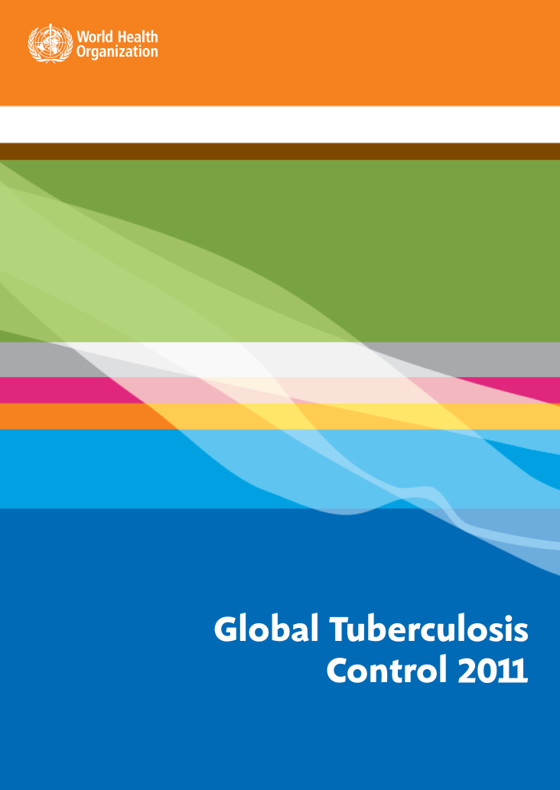
Multidrug-resistant tuberculosis : update 2011

Slide 2
The Global Plan to Stop TB, 2011-2015 (1)
Between 2011 and 2015 …
Increase in TB cases tested for R & H yearly from 0.8 million to 1.9 million
1 million multidrug-resistant TB (MDR-TB) patients detected and put on treatment
USD 7.1 billion spent
Notes:
In 2010, the Stop TB Partnership launched its Global Plan to Stop TB, 2011-2015 having, as an ultimate focus, the elimination of TB in the world by 2050. The plan has important implications for the funding of MDR-TB activities in detecting patients, notifying and enrolling them on treatment.

Slide 3
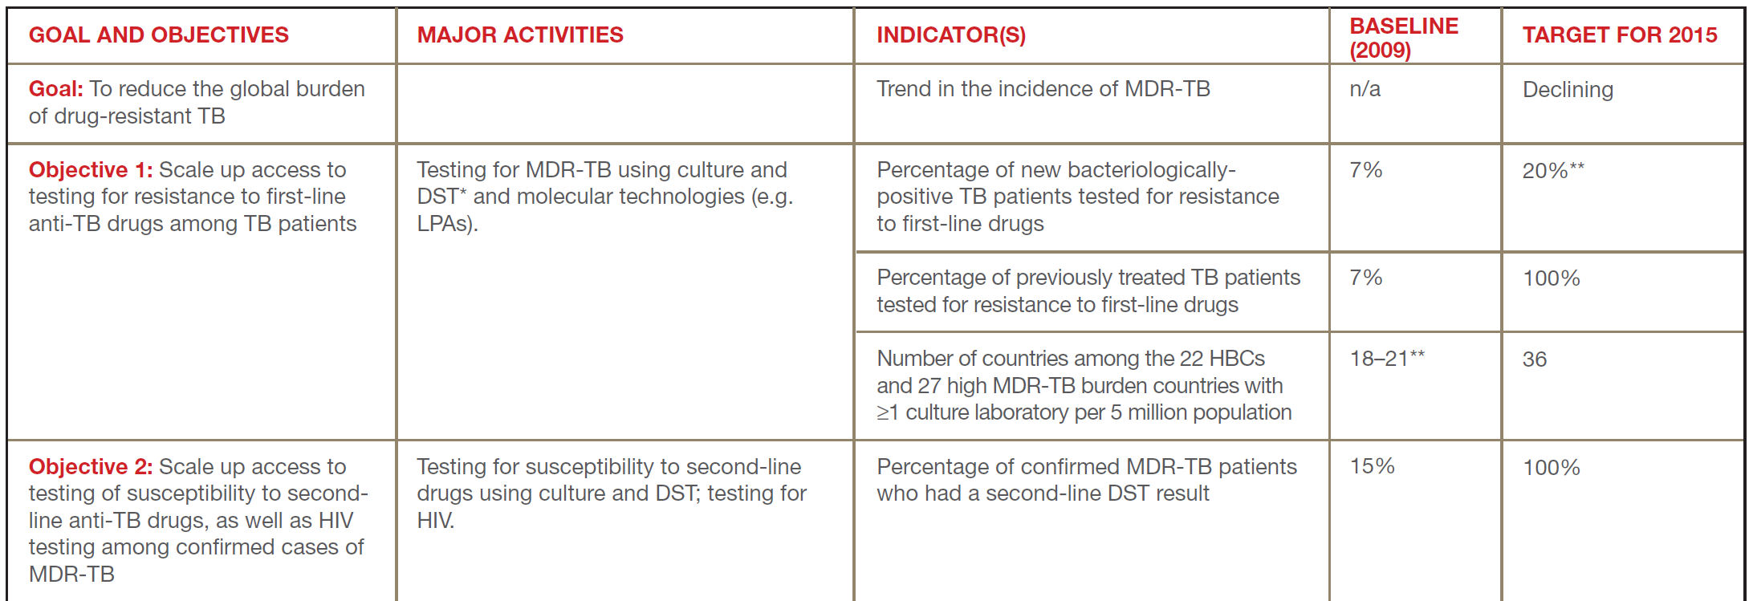
The Global Plan to Stop TB, 2011-2015 (2)
Notes:
The plan includes 6 objectives aimed at reducing the global burden of drug-resistant TB with intermediate targets to be reached by 2015.

Slide 4
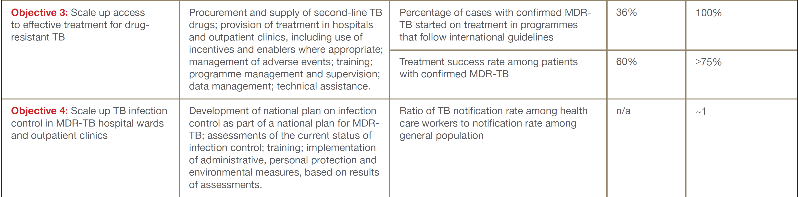
The Global Plan to Stop TB, 2011-2015 (3)

Slide 5
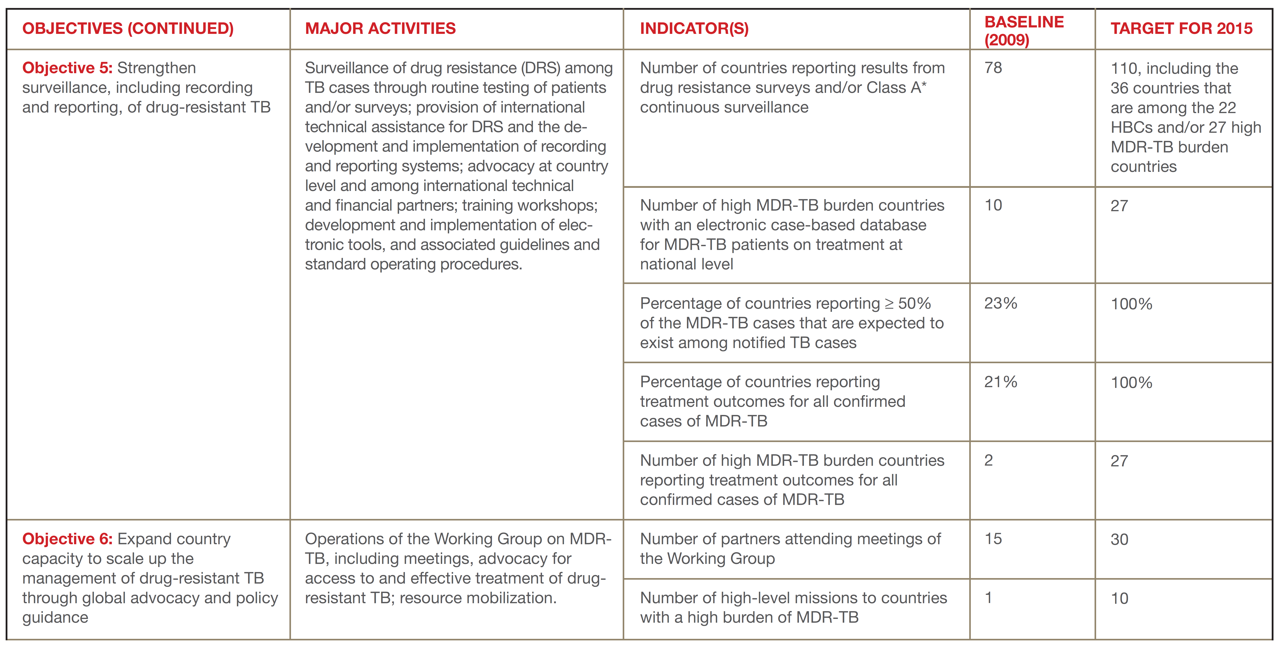
The Global Plan to Stop TB, 2011-2015 (4)
Source: The Global Plan to Stop TB 2011-2015 (www.stoptb.org/assets/documents/global/plan/TB_GlobalPlanToStopTB2011-2015.pdf)

Slide 6
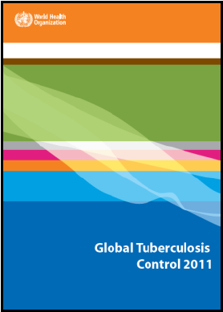
The global TB situation (1)
Estimated number of cases, 2010
Estimated number of deaths, 2010
All forms of TB
8.8 million
(8.5–9.2 million)
1.1 million*
(0.9–1.2 million)
HIV-associated TB
1.1 million
(1.0–1.2 million)
350,000
(320,000–390,000)
Multidrug-resistant TB
~ 650,000
out of 12 million (11-14 million) prevalent TB cases
* Excluding deaths attributed to HIV/TB
Source: WHO Global Tuberculosis Control Report 2011 (www.who.int/tb/publications/global_report/2011/gtbr11_full.pdf)
Notes:
In 2010 it was estimated that 8.8 million incident TB cases occurred in the world. Out of the 12 million prevalent TB cases, around 650,000 were estimated to be multidrug-resistant.

Slide 7
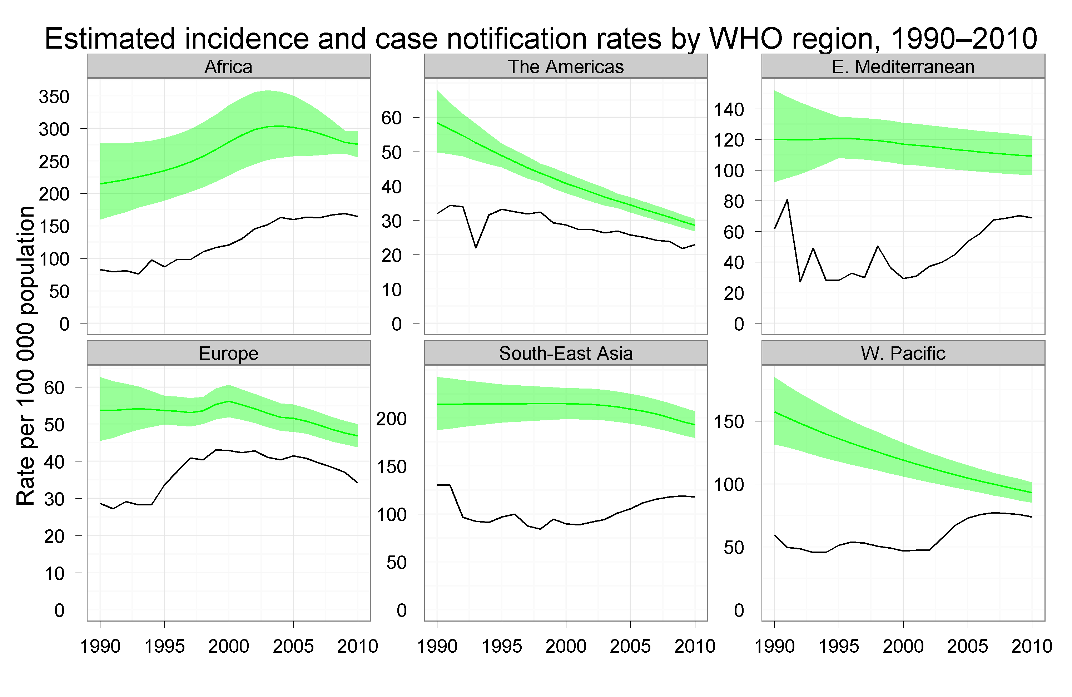
The global TB situation (2)
Notes:
Overall TB incidence (green lines) has been declining steadily in all the Regions of the world for several years.

Slide 8
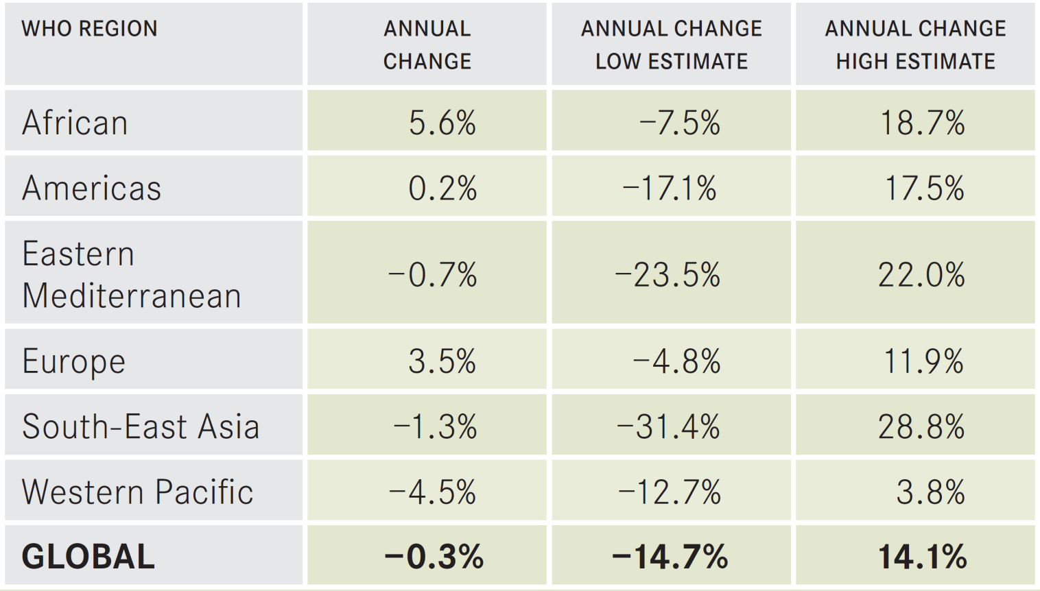
Time trends in MDR-TB
Available data from 74 countries and territories with measurements for at least two years could not answer the question of whether the proportion of previously untreated TB cases with MDR was increasing, decreasing or stable over time at a global or regional level.
Notes:
However it is difficult to conclude on global or regional trends in MDR-TB incidence as a result of incomplete data on the frequency of MDR among TB cases. For some countries (eg. Latvia, USA) and regions (eg, Orel and Tomsk in the Russian Federation) time trends based on observations over several years indicate a decrease in MDR-TB frequency of late, while in others (eg, Botswana and Swaziland) there appears to be an increase.

Slide 9
Proportion of MDR among new TB cases
Latest available data, 1994-2010
The boundaries and names shown and the designations used on this map do not imply the expression of any opinion whatsoever on the part of the World Health Organization concerning the legal status of any country, territory, city or area or of its authorities, or concerning the delimitation of its frontiers or boundaries. Dotted lines on maps represent approximate border lines for which there may not yet be full agreement.
© WHO 2011. All rights reserved
Notes:
Another cause of concern is that the highest frequencies of MDR-TB ever reported occurred in recent years. In countries like Belarus and parts of the Russian Federation more than a quarter of new TB cases now have MDR-TB. Swaziland reported the highest level of primary MDR ever reported in Africa in 2009 (7.7%).

Slide 10
Proportion of MDR among previously treated TB cases
Latest available data, 1994-2010
The boundaries and names shown and the designations used on this map do not imply the expression of any opinion whatsoever on the part of the World Health Organization concerning the legal status of any country, territory, city or area or of its authorities, or concerning the delimitation of its frontiers or boundaries. Dotted lines on maps represent approximate border lines for which there may not yet be full agreement.
© WHO 2011. All rights reserved
Notes:
While MDR occurs in about 3.4% (95%CI 1.9%-5.0%) of new TB patients, levels are much higher in those previously treated – 20% (95%CI 14%-25%)

Slide 11
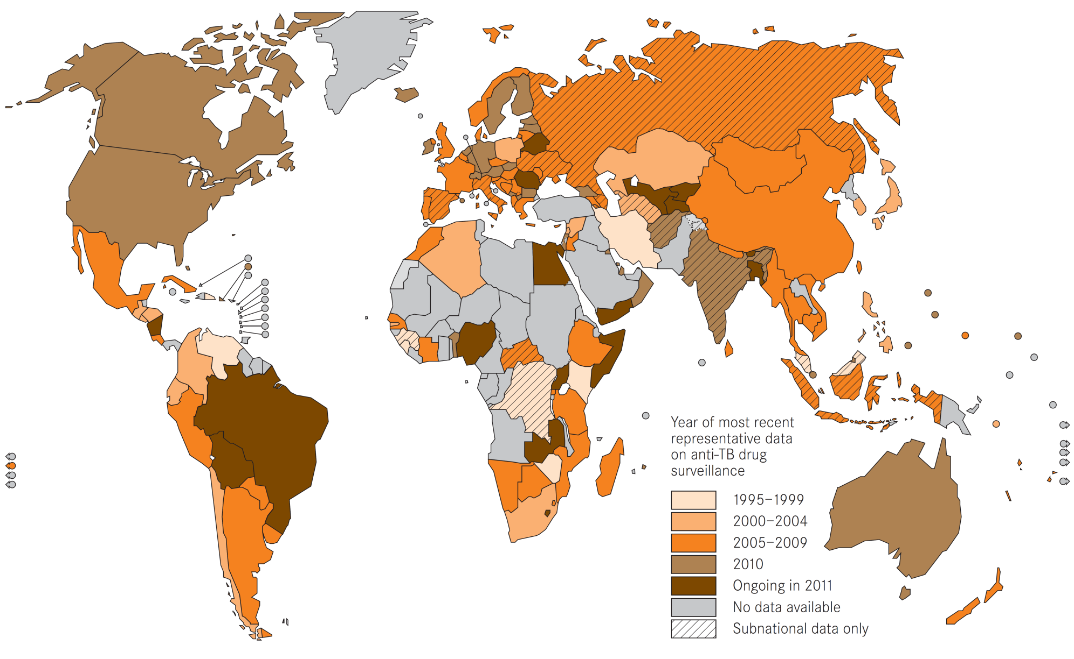
Global coverage of drug resistance surveillance data
The boundaries and names shown and the designations used on this map do not imply the expression of any opinion whatsoever on the part of the World Health Organization concerning the legal status of any country, territory, city or area or of its authorities, or concerning the delimitation of its frontiers or boundaries. Dotted lines on maps represent approximate border lines for which there may not yet be full agreement. © WHO 2011. All rights reserved
Notes:
There has been important progress in recent years in the global coverage of data on anti-TB drug resistance. To date, 136 countries have data from at least one representative survey or from good-quality continuous surveillance systems, including 32 of the 36 countries with a high burden of TB, MDR-TB or both.

Slide 12
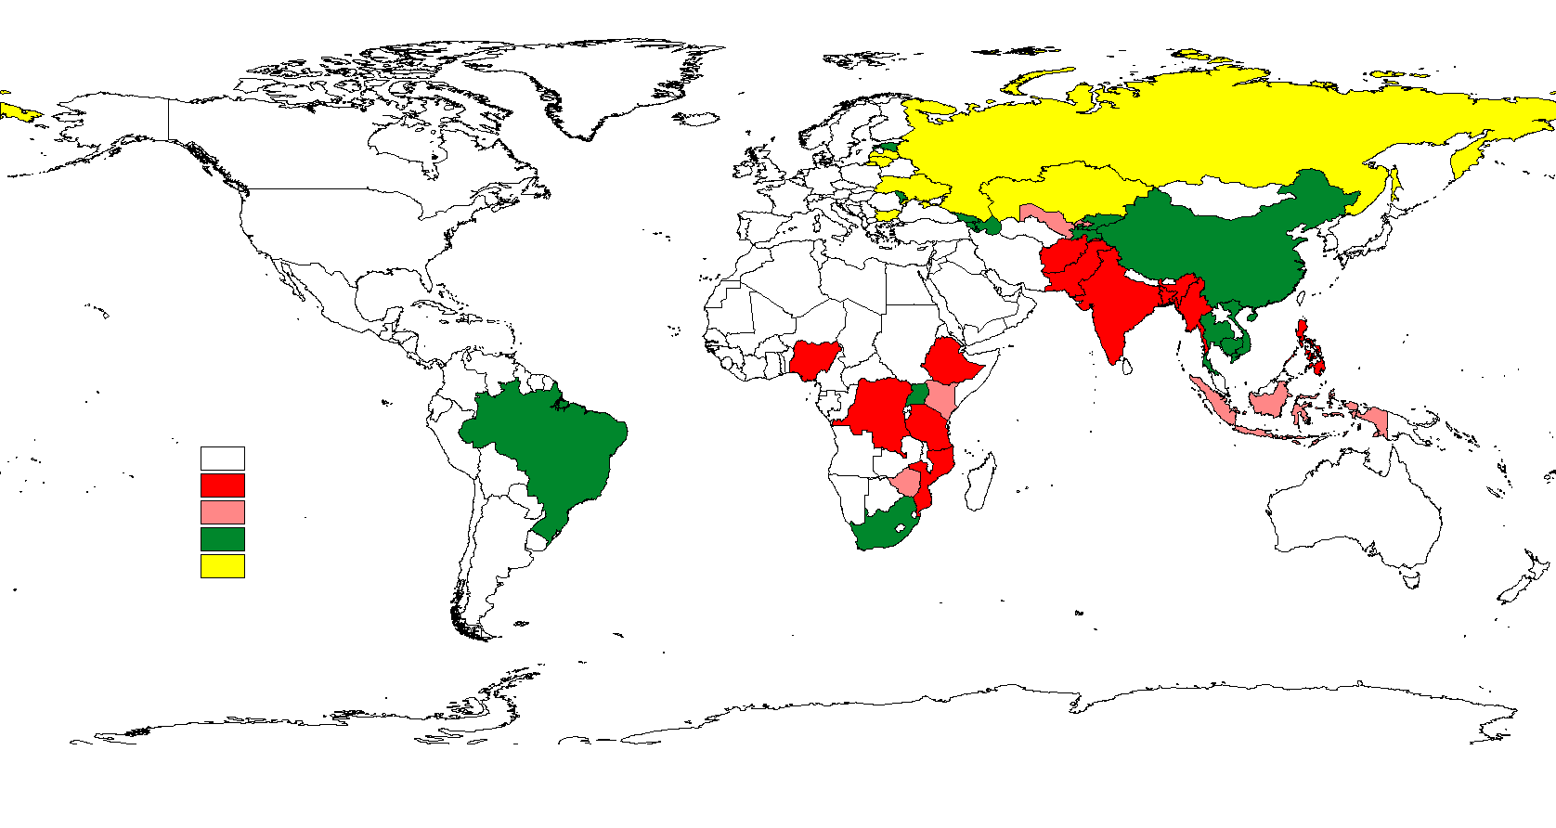
Laboratories doing culture for TB per 5 million population Countries with high burden of TB, MDR-TB or both, 2010
*
Not high burden
0.0-0.50
0.51-0.99
1.00-8.00
>8.00
*No data
The boundaries and names shown and the designations used on this map do not imply the expression of any opinion whatsoever on the part of the World Health Organization concerning the legal status of any country, territory, city or area or of its authorities, or concerning the delimitation of its frontiers or boundaries. Dotted lines on maps represent approximate border lines for which there may not yet be full agreement. © WHO 2011. All rights reserved
Notes:
In 2010, 20 of the 36 countries with a high burden of TB or MDR-TB had at least one laboratory capable of performing culture for tuberculosis per 5 million population. The Global Plan target for 2015 is that all of these countries reach the minimum threshold. In most of the high burden countries in Africa and the Indian sub-continent, the coverage is particularly low, while conversely many of the countries in eastern Europe are overprovided raising concerns about the quality of analyses performed.

Slide 13
Diagnostic DST for rifampicin and isoniazid (1)
Among new TB cases, by Region, 2010
35%
30.4%
30%
25%
20%
15%
10%
5.0%
5%
1.8%
0.2%
0.6%
0.1%
0.4%
0%
AFR
AMR
EMR
EUR
SEAR
WPR
Global
Notes:
Less than 2% of new TB cases (4% of those bacteriologically positive) were reported to have been tested in 2010, far short of the 20% considered necessary according to the Global Plan. This target, however, has already been reached in the European Region. The lack of data is partly a result of insufficient access of TB patients to drug-susceptibility testing (DST). Another reason could be low capture of results from laboratories owing to inadequate TB information systems.

Slide 14
Diagnostic DST for rifampicin and isoniazid (2)
Among previously treated TB cases, by Region, 2010
60%
50.7%
50%
40%
30%
20%
18.5%
10%
6.3%
6.4%
2.8%
1.6%
0.3%
0%
AFR
AMR
EMR
EUR
SEAR
WPR
Global
Notes:
DST coverage is higher among previously treated patients but still distant from the overall target of 100% in 2015, including the European Region.

Slide 15
DST coverage for second-line drugs
among MDR-TB cases, 2010
70%
60%
50%
40%
30%
20%
10%
0%
AFR
AMR
EMR
EUR
SEA
WPR
Global
Notes:
Representative data from different countries show that about 9% of MDR-TB cases have extensive drug resistance (XDR-TB), with additional resistance to a fluoroquinolone and a 2nd line injectable agent. The detection of XDR is important for programme management and 2nd line DST is recommended for all confirmed MDR-TB patients. In 2010, only 16% of MDR-TB patients were reported with a test result. The high coverage in Africa drops to 12% without the data from South Africa.

Slide 16
Countries that had reported at least one
XDR-TB case by Oct 2011
Notes:
By October 2011, 77 countries had reported at least one case of XDR. Coverage is low particularly in the African continent as a result of low capacity for testing for second-line medicines.

Slide 17
MDR-TB notification and enrolment (1)
Notified cases of MDR-TB (2007–2010) and projected numbers of patients to be enrolled on treatment (2011-2012) compared with the targets included in the Global Plan to Stop TB 2011–2015.
300,000
GLC
Not GLC
Global Plan 2010 projections
Projected enrolments
250,000
200,000
150,000
100,000
50,000
0
2007
2008
2009
2010
2011
2012
2013
2014
2015
Notes:
A substantial increase in the notification of MDR-TB cases occurred since 2008 although the projected enrolments of MDR-TB cases in 2011 is less than one half of what was aimed for in the Global Plan. In the 149 focus countries in the plan, at least one quarter of MDR-TB patients notified in 2010 were enrolled in treatment programmes complying to international guidelines established by the Green Light Committee (GLC).

Slide 18
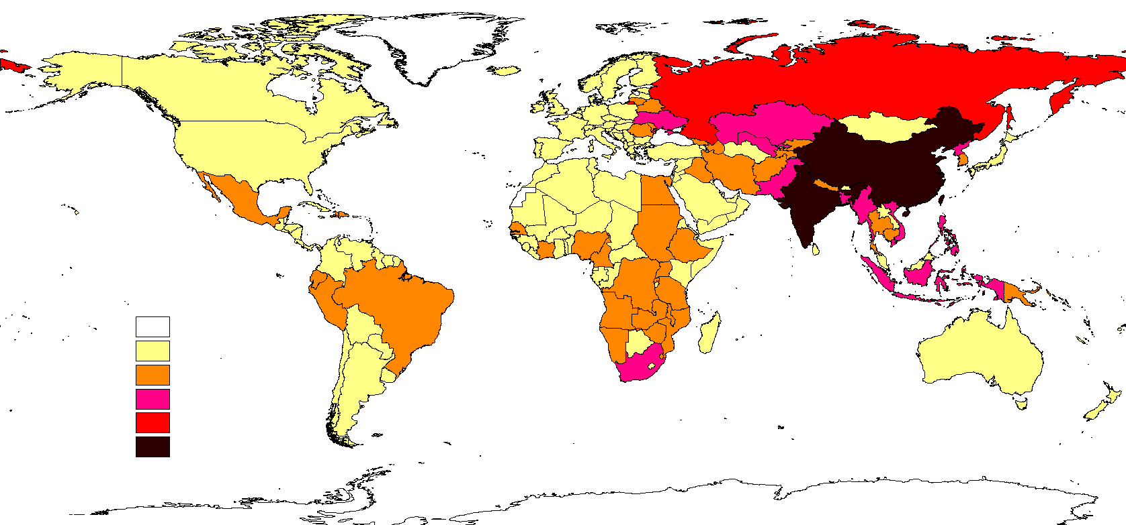
MDR-TB notification and enrolment (2)
Estimated MDR-TB cases among notified TB patients in 2010
No data
0-300
301-3,000
3,001-30,000
30,001-60,000
>60,000
The boundaries and names shown and the designations used on this map do not imply the expression of any opinion whatsoever on the part of the World Health Organization concerning the legal status of any country, territory, city or area or of its authorities, or concerning the delimitation of its frontiers or boundaries. Dotted lines on maps represent approximate border lines for which there may not yet be full agreement.
© WHO 2011. All rights reserved
Notes:
This slide shows the absolute number of MDR-TB cases by country among the new and retreated TB cases notified in 2010. No adjustment for under-notification of TB cases was done but in countries without a measured estimate of MDR among TB cases a modelled value was used. Over 60% of cases occur in China, India, the Russian Federation and South Africa alone (“RICS” countries).

Slide 19
MDR-TB notification and enrolment (3)
MDR cases reported vs estimated among notified TB, 2010
WHO Region | 2010
 | Estimated | Reported | Ratio
African | 32,000 | 9,504 | 30%
American | 6,200 | 2,158 | 35%
East Med. | 14,000 | 829 | 6%
European | 53,000 | 32,616 | 62%
S-E Asian | 88,000 | 3,779 | 4%
West Pacific | 77,000 | 4,222 | 5%
Global | 290,000 | 53,108 | 18%
Notes:
When compared to the number of detectable MDR-TB cases if DST was accessible to all TB cases notified in the world, the 53 thousand cases reported by countries in 2010 represent less than a fifth of the estimated burden. Regional variations are large and coverage is lowest in the regions where the large majority of TB cases occur. 56 of the 135 countries (42%) with at least one case of MDR-TB in 2010 reported >50% of their estimated MDR-TB caseload. All countries are targeted to achieve this level of reporting completeness by 2015.

Slide 20
Outcomes of MDR-TB treatment
For MDR-TB patients started on treatment in 2008*
100%
80%
60%
40%
20%
0%
Kazakhstan
Turkey (263)
Uzbekistan
Ecuador (210)
Georgia (417)
Democratic
Philippines
Namibia (221)
Russian
Brazil (444)
Kyrgyzstan
Republic of
South Africa
Romania (816)
(2268)
(294)
Republic of the
(520)
Federation
(262)
Moldova (522)
(4383)
Congo (202)
(1537)
Success
Died
Failed
Defaulted
Not evaluated
* In countries reporting outcomes for >200 MDR-TB cases with <20% unevaluated (cohort size shown below country names)
Notes:
The proportion of MDR-TB patients with a successful outcome varied substantially between countries and averaged to about 53% globally. Of the 91 countries reporting outcomes, only 20 achieved or exceeded the Global Plan target of 75% success, three of them having cohorts of at least 50 patients. In 52/91 countries, the number of MDR-TB patients for whom outcomes were reported represented >90% of the number of MDR-TB patients notified by the country for 2008. Seventeen of the 27 high MDR-TB burden countries reported outcomes, eight of them with cohorts similar in size to the notified MDR-TB cases (>90%). By 2015, all countries are expected to report outcomes for all confirmed MDR-TB cases.

Slide 21
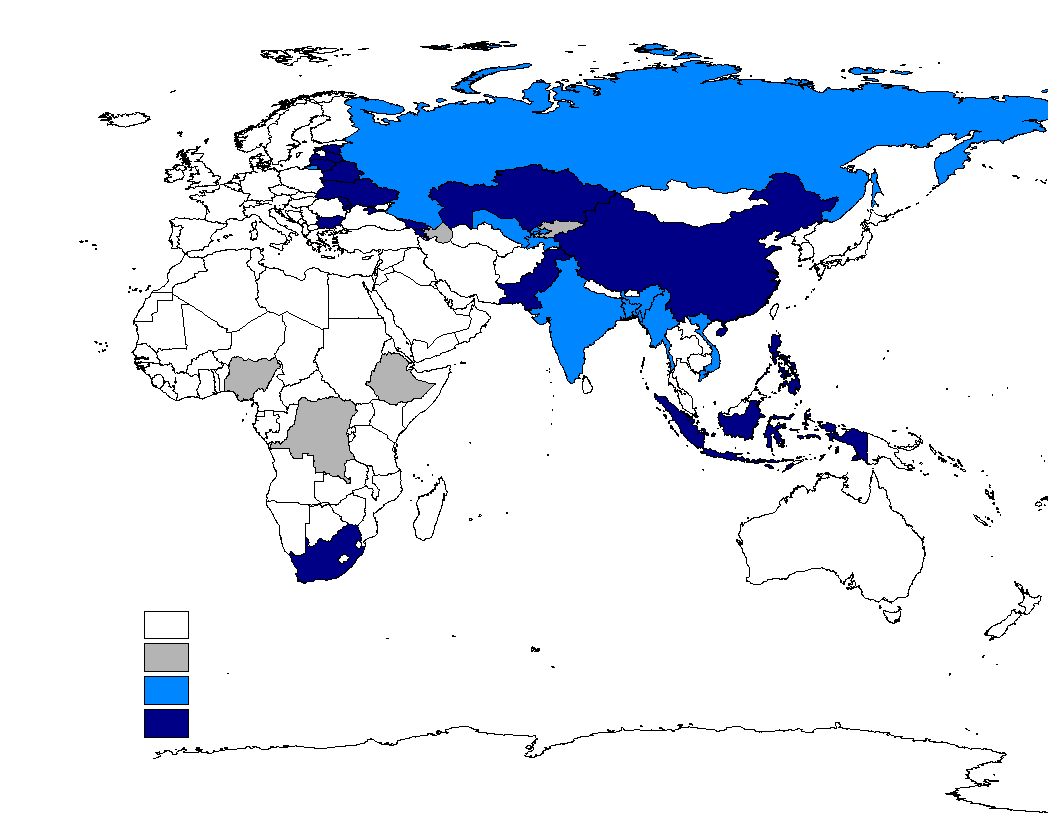
Use of electronic solutions for the management
of MDR-TB patient data, by October 2011
Not high burden
No system or incomplete information
Planning new systems
Using systems
The boundaries and names shown and the designations used on this map do not imply the expression of any opinion whatsoever on the part of the World Health Organization concerning the legal status of any country, territory, city or area or of its authorities, or concerning the delimitation of its frontiers or boundaries. Dotted lines on maps represent approximate border lines for which there may not yet be full agreement. © WHO 2011. All rights reserved
Notes:
By 2015, all the 27 high MDR-TB burden countries are expected to manage nationwide data electronically for MDR-TB patients on treatment. Extensive systems are operated in China, South Africa and most countries in the European Region but are lacking in three of the four high MDR-TB burden countries in Africa and are still being planned in Bangladesh, Myanmar and India among others.

Slide 22
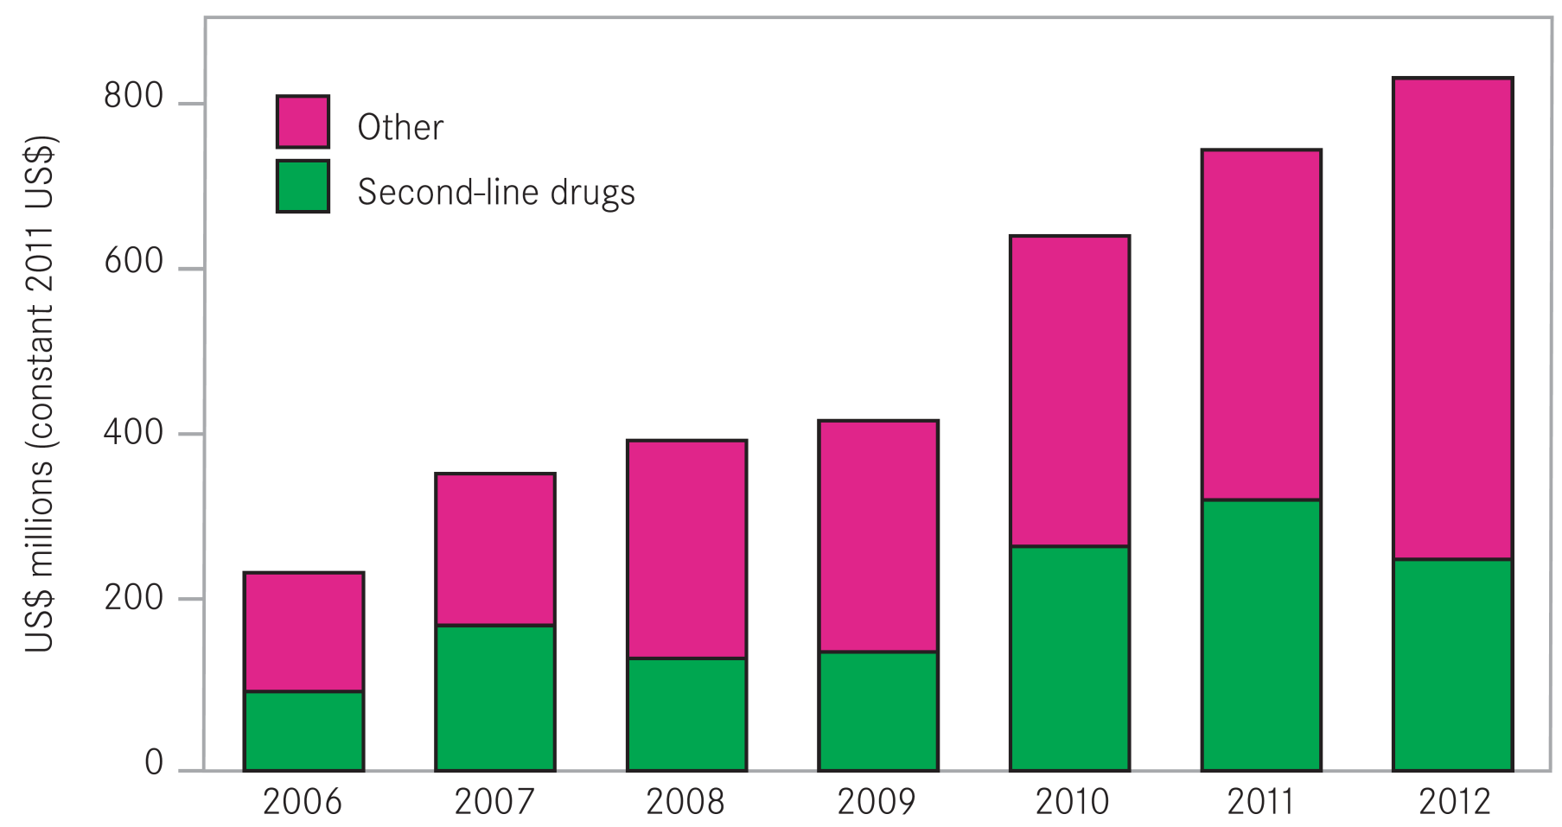
Funding for MDR-TB (1)
Funds available for MDR-TB, 2006-2012*
* In 106 countries with 96% of MDR-TB cases enrolled in 2010
Notes:
Funding available for MDR-TB has increased since 2006. In 2011, South Africa, the Russian Federation and Kazakhstan by themselves accounted for USD 0.5 billion. Second-line drugs represent 30–50% of total funds allocated. Since 2006, domestic sources financed 60–94% of the NTP budgets. Low-income countries will need financial support from external grants. The value of grants for MDR-TB from the Global Fund is growing, and reached USD 0.13 billion in 2011. The funding that is available for MDR-TB is much lower than what was set out in the Global Plan (USD 0.9 billion in 2011 to USD 1.9 billion in 2015). To reach the planned targets, substantial resource mobilization will be needed. The price of treating a patient – which averaged to about USD 8200 in the 27 high MDR-TB burden countries in 2009–2011, with large variations – could be brought down substantially through ambulatory models of care.

Slide 23
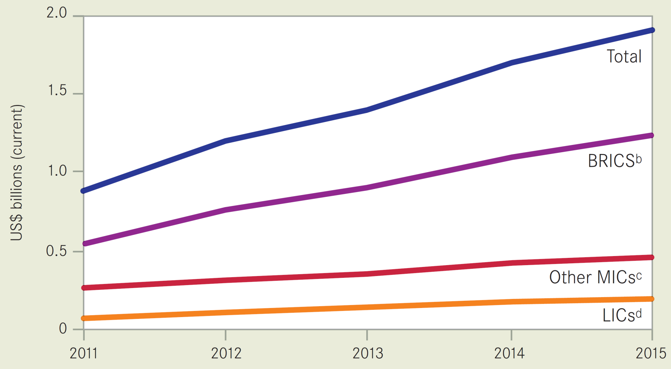
Funding for MDR-TB (2)
Funding required for MDR-TB*
BRICS=Brazil, the Russian Federation, India, China and South Africa. MICS=Middle-income countries (excluding BRICS). LICS=Low-income countries.
* As per Global Plan to Stop TB, 2011-2015
Notes:
A new analysis suggests that most of the funding required for scaling up MDR-TB diagnosis and treatment could come from domestic sources in BRICS and other middle-income countries. Low-income countries (LICs) in contrast will need financial support from external grants. If current levels of donor funding would be focused on LICs they would almost suffice to finance their scale-up of MDR-TB care in line with the targets included in the Global Plan.

Slide 24
Conclusions (1)
Even if most TB patients in the world are not drug-resistant, they present a formidable challenge to global TB control.
Treatment of MDR-TB is longer, more complicated and less effective than for drug-susceptible TB. Most programmes in the world recruit small numbers of patients and successful outcome is achieved in <75% of individuals overall, the threshold envisaged for 2015 by the Global Plan.

Slide 25
Conclusions (2)
Coverage of DST for TB patients remains low and resultantly a minority of drug-resistant TB patients are detected and notified. Information remains incomplete.
To reach the Global Plan targets, substantial resource mobilization will be needed, both from domestic and from external sources. The price of treating a patient needs to be reduced.

Slide 26
Acknowledgements
Stop TB Dept (TME, TBL, MDR/GLC)
Stop TB Partnership

