Slide 1

Collaborative TB/HIV activities 2012
Tables, Graphs & Maps
Source: Global Tuberculosis Control Report 2013
http://www.who.int/tb/publications/global_report/en/

Slide 2
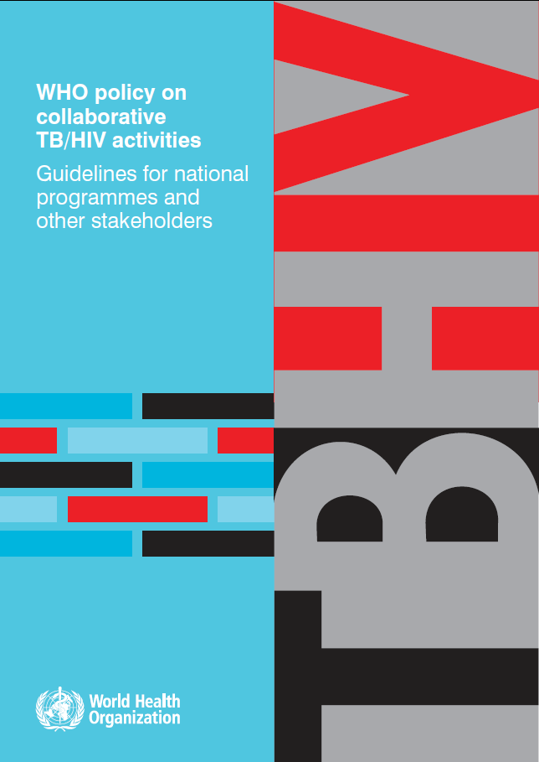
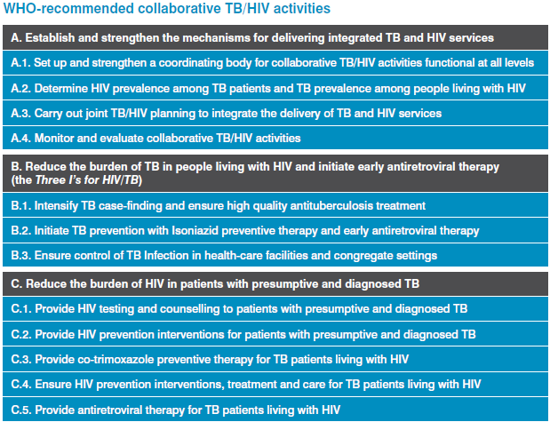
The 2012 WHO Policy

Slide 3
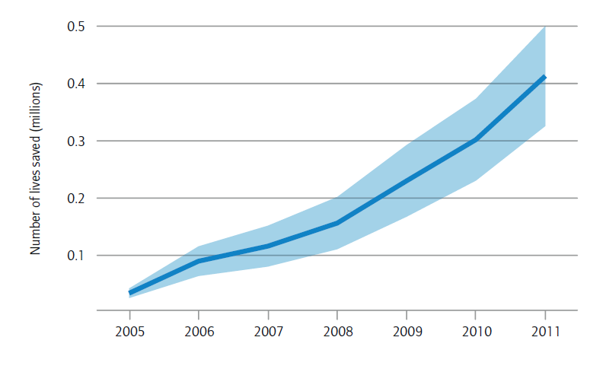
Estimated number of lives saved globally by the implementation of TB/HIV interventions, 2005-2011
Blue band represents the uncertainty interval

Slide 4
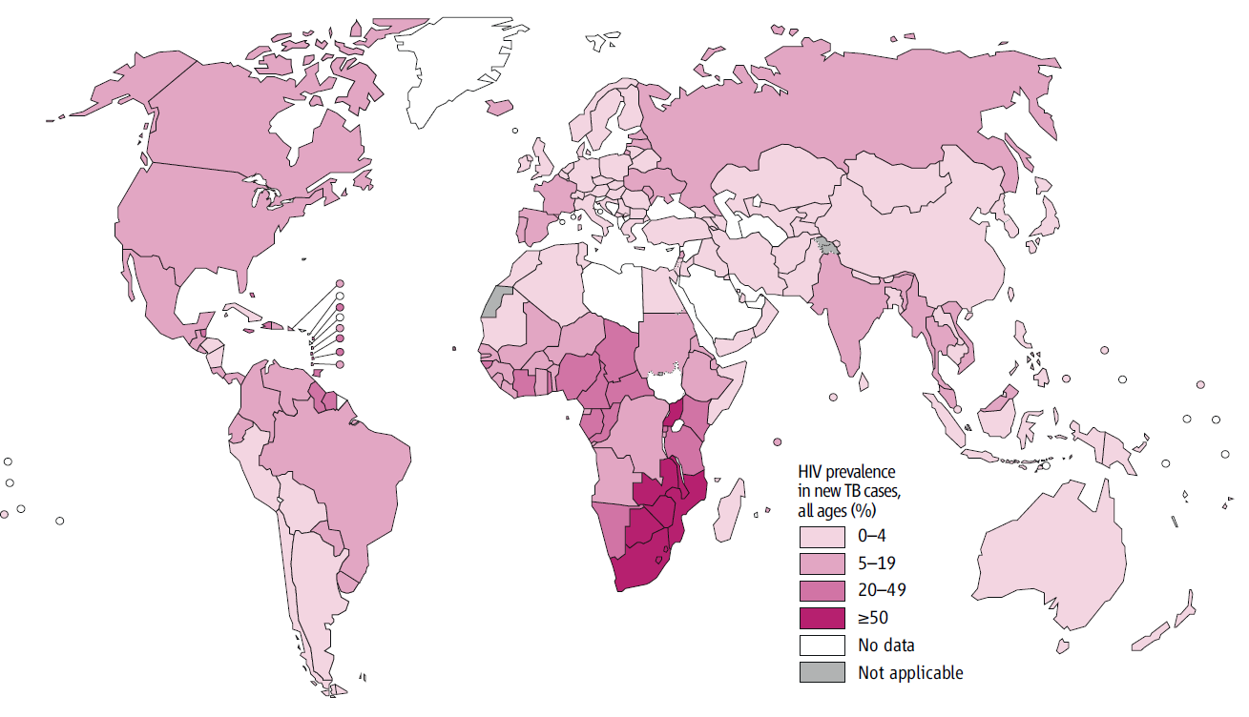
Estimated HIV prevalence among new TB cases, 2012

Slide 5
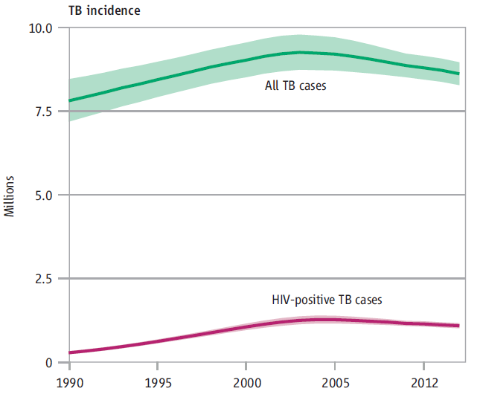
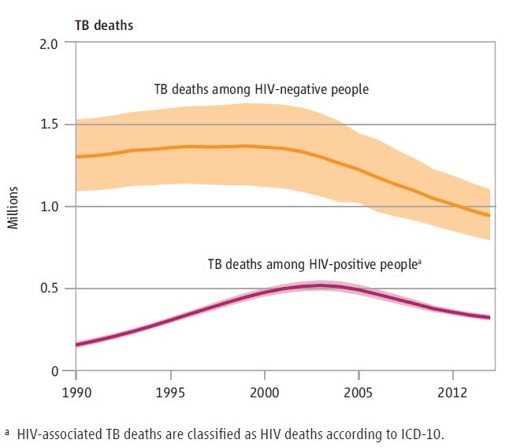
Estimated HIV-associated TB incidence and mortality globally, 1990-2012

Slide 6
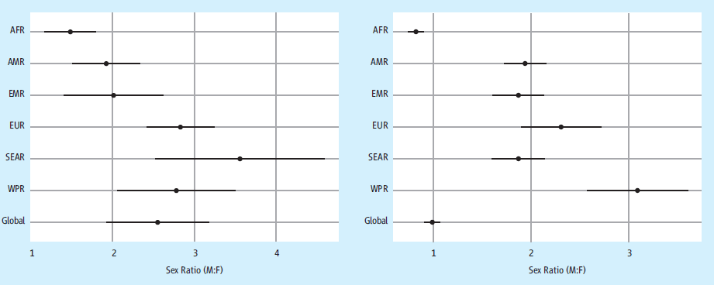
Male-female ratio of TB deaths by HIV status among adults* globally and by WHO region, 2012
HIV-negative TB deaths HIV-associated TB deaths
* Defined as people aged ≥15 years

Slide 7
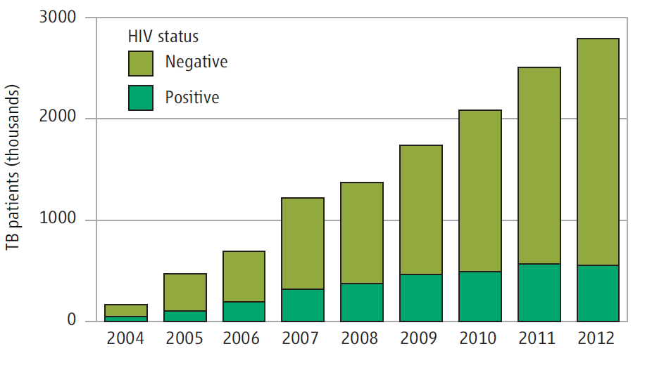
Number of TB patients with known HIV status 2004-2012

Slide 8
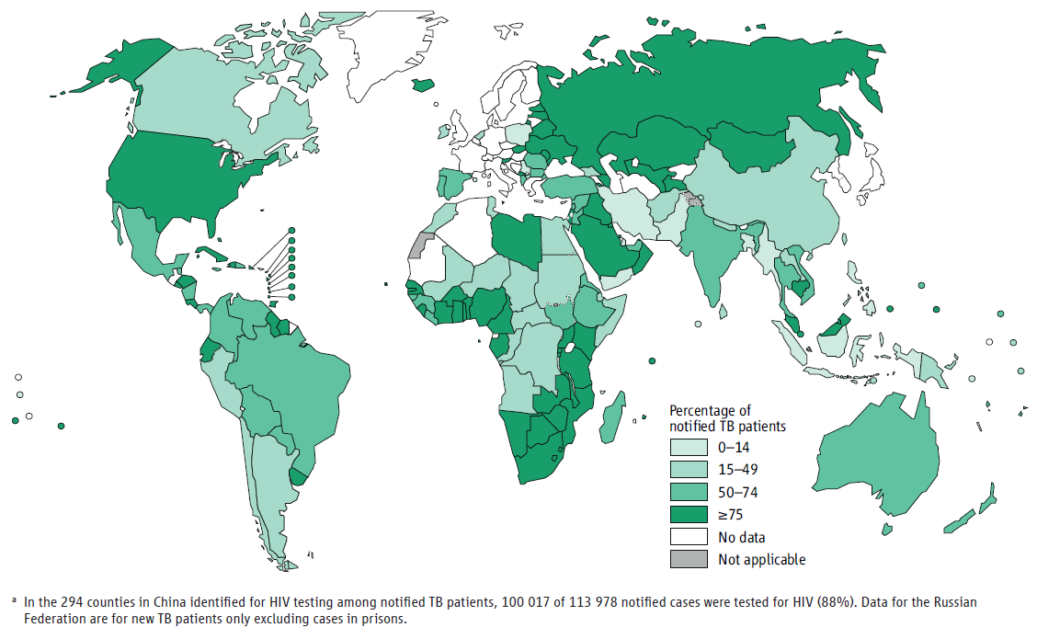
Percentage of TB patients with known HIV status by country, 2012ª

Slide 9
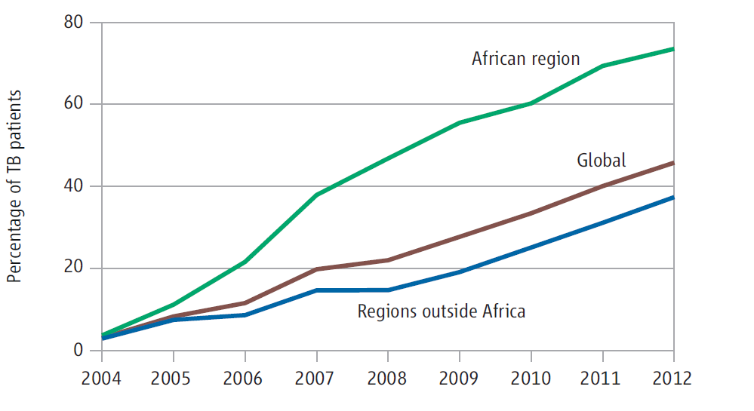
Percentage of TB patients with known HIV status, 2004-2012

Slide 10
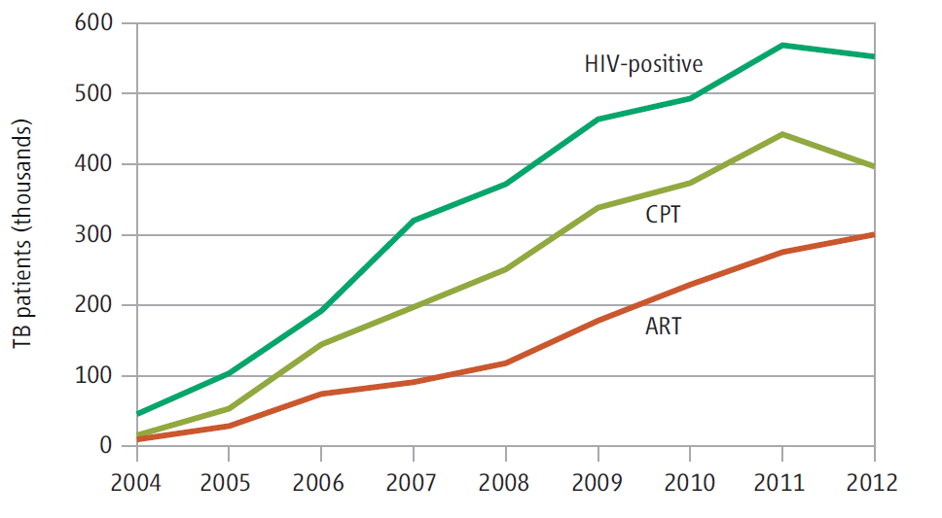
Number of HIV-positive TB patients enrolled on co-trimoxazole preventive therapy (CPT) and antiretroviral therapy (ART), 2004-2012

Slide 11
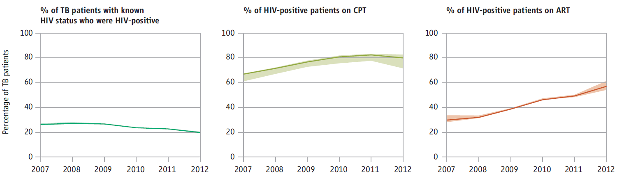
Percentage of TB patients with known HIV status who were HIV positive, percentage of HIV-positive TB patients enrolled on co-trimoxazole preventive therapy (CPT) and antiretroviral therapy (ART), 2006-2012*
* The solid lines show values for countries that reported data. The shaded areas show upper and lower limits when countries that did not report data are considered.

Slide 12
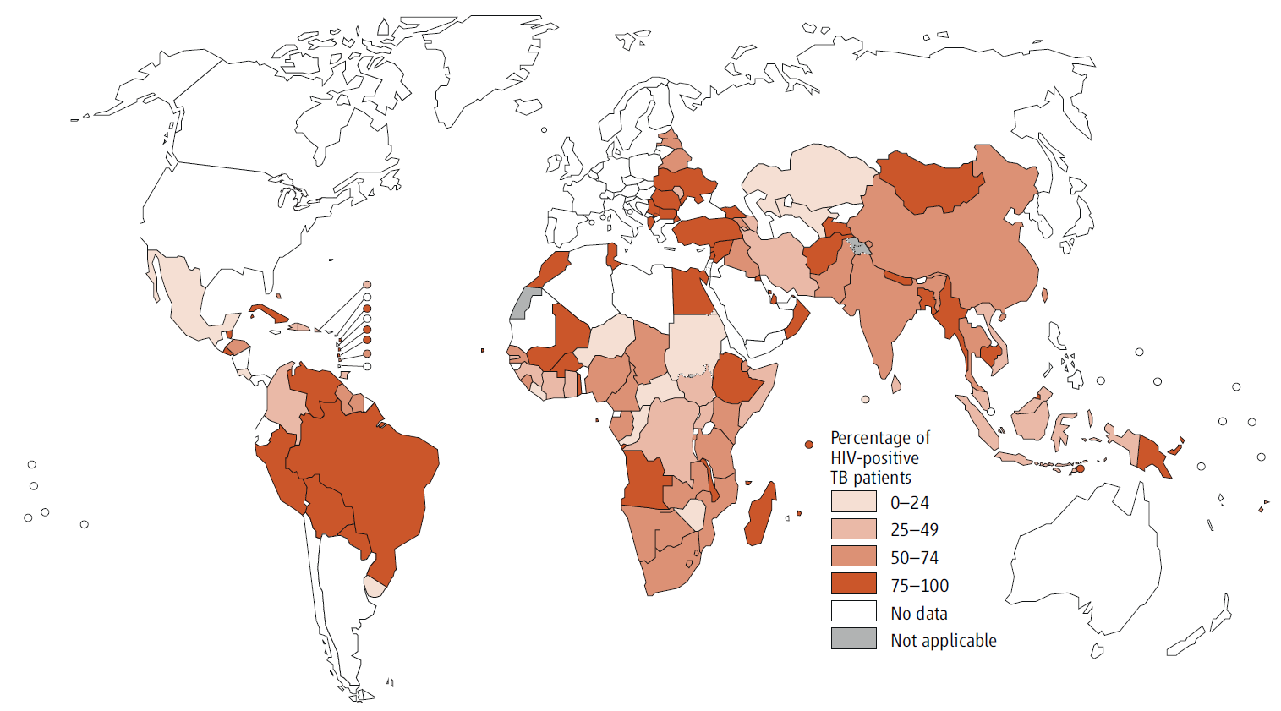
Percentage of HIV-positive TB patients enrolled on antiretroviral therapy (ART), 2012

Slide 13
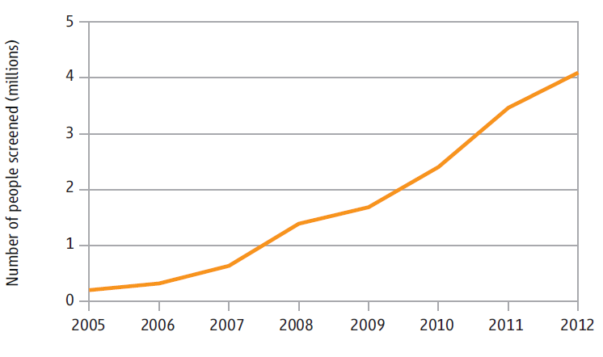
Intensified TB case-finding among people living with HIV, 2005-2012

Slide 14
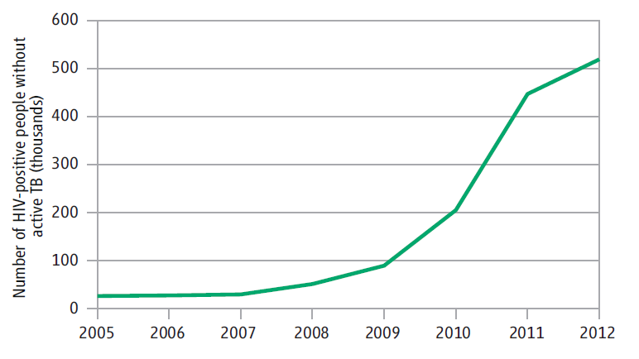
Provision of isoniazid preventive therapy (IPT) to people living with HIV without active TB, 2005-2012

Slide 15
Collaborative TB/HIV activities per Region, 2012
 | Estimated HIV-positive incident TB cases |  |  | # of TB patients with known HIV status | % of notified TB patients tested for HIV | % of tested TB patients HIV-positive | % of identified HIV positive TB patients started on CPT | % of identified HIV positive TB patients started on ART | # of PLHIV screened for TB | # of PLHIV started on IPT
 | Best | Low | High
AFR | 830 | 760 | 910 | 1 040 | 74 | 43 | 79 | 55 | 2 392 | 473
AMR | 31 | 28 | 34 | 129 | 56 | 16 | 61 | 76 | 4.5 | 19
EMR | 11 | 10 | 12 | 58 | 14 | 3.5 | 69 | 48 | 15 | 0.2
EUR | 19 | 17 | 21 | 204 | 60 | 6.3 | 67 | 74 | 24 | 18
SEAR | 170 | 160 | 180 | 904 | 39 | 6.2 | 89 | 61 | 1 352 | < 0.01
WPR | 24 | 21 | 27 | 451 | 34 | 3.1 | 79 | 56 | 308 | 8.6
Global | 1 100 | 1 000 | 1 200 | 2 787 | 46 | 20 | 80 | 57 | 4 095 | 519
Numbers in thousands

Slide 16
Collaborative TB/HIV activities 2004-2012
Global

Slide 17
Collaborative TB/HIV activities 2004-2012
African Region

Slide 18
Collaborative TB/HIV activities 2004-2012
American Region

Slide 19
Collaborative TB/HIV activities 2004-2012
EMRO

Slide 20
Collaborative TB/HIV activities 2004-2012
EURO

Slide 21
Collaborative TB/HIV activities 2004-2012
SEARO

Slide 22
Collaborative TB/HIV activities 2004-2012
WPRO

