Slide 1
Data for Action on TB Key, Vulnerable and Underserved Populations
Colleen Daniels
Human Rights, Gender, TB/HIV Advisor
Sept 2017
colleend@stoptb.org

Slide 2
Definition to Identify TB Key Populations

Slide 3
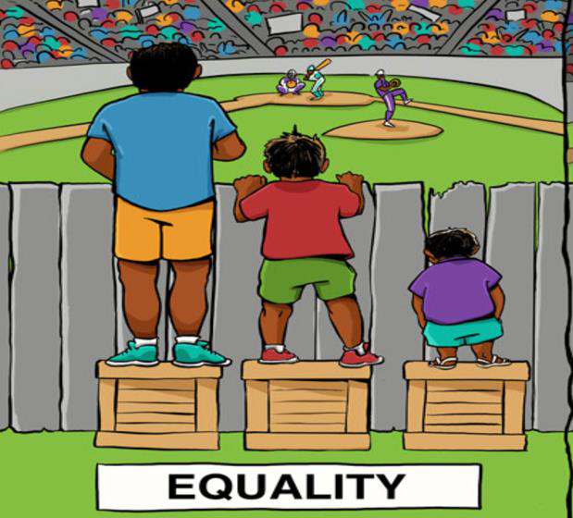
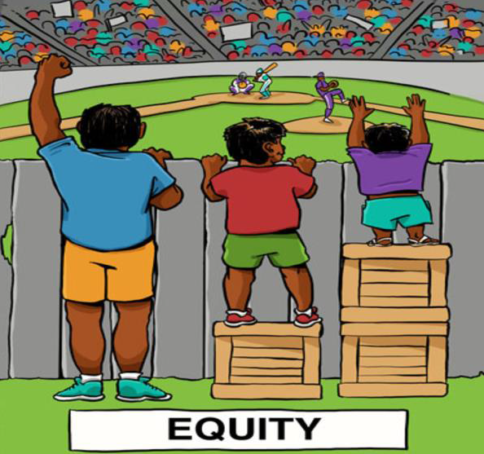
Understanding Key Populations
Source: Cultural Organization (culturalorganizing.org).

Slide 4
Data for TB Key Pops Framework Structure
Possible TB Key Populations
Overarching Principles
Multi-stakeholder
Prioritizing and Planning Programs for Key Populations
Specific TB risks, risk drivers, service access barriers
Different countries, different context, different key populations
Five possible key popula-tions to illustrate
Limited Data and Filling Data Gaps
Service Cascade
Tracking from first client contact to treatment success
Community-based Monitoring
Service quality feedback
Resourcing
Costs, Savings and Financial Resources
Human Resources
Information Updates
Scientific Expertise
Systema-tically consider all possible population groups at higher risks
Participa-tory
Human Rights-based
Gender-responsive
Evidence-driven
Local-level population size estimates, disease burden and risks
National-level population size estimates and risks
National Strategic Plan
Understand-ing and Defining Key Populations
Sampling to get city-level estimates
Deriving national estimates from city-level ones
Monitoring and Evaluation
District/City-level Service Planning
Strengthening public TB services
Coordination: Public TB & other government services
Coordination: Government and CSO services
Strengthening CSO service delivery capacity
Five possible key populations to illustrate data limitation
National-level prioritization of key populations
Rapid assessment / formative research

Slide 5
Prioritizing Key Populations
Estimated Contribution to Country’s Disease Burden | % of all active TB cases | 1 – Very Low (<1%) 2 – Low (1-3%) 3 – Medium (3-5%) 4 – High (5-10%) 5 – Very High (>10%)
Environmental Risks | Over-crowded Poorly ventilated space Reside in zoonotic TB areas | 0 – No 1 – Yes
Biology risks | Reduced immunity Poor nutrition | 0 – No 1 – Yes
Behavioral risks | Drug use Alcohol use | 0 – No 1 – Yes
Legal, Economic Barriers | Criminalization Poverty Sanctions | 0 – No 1 – Yes
Human Rights Barriers Gender Barriers | Stigma Discrimination | 0 – No 1 – Yes

Slide 6
National Strategic Plan
Key Populations Prioritized
Estimated size of prioritized key populations in the country (age and sex disaggregated)
Where are they concentrated (geographically, digitally)?
What are their key TB risks (environment, biology, behavior, limited access to services) and related drivers (legal, economic, human rights, gender)?
What are their TB case finding and treatment services challenges?
What TB service package and integration with other services are needed to address these challenges (health, harm reduction, social, community, immigration, labour, police)?
Preliminary national targets (outreached, screened, tested, treated, treatment completion)
Service and Data gaps that need to be addressed?

Slide 7
TB/HIV Gender Assessment Tool
STAGE 1 Preparing for the gender assessment of the national HIV/TB response
STAGE 2 Knowing the national HIV and TB epidemics and contexts
STAGE 3 Knowing the national HIV and TB responses
STAGE 4 Analysing and using the findings of the assessment for a gender-transformative HIV and TB response

Slide 8
Potential Results
Key gender issues | Recommended HIV and TB gender interventions | Remarks
Legal/Political
D1. HIV and TB-related discrimination cases are rarely if ever brought to court by women, men and key populations due to lack of a clear process and an enabling environment. | D1.a. Community organizing and mobilization, including “know your rights” initiatives and engagement with customary leaders, can help women, men and key populations claim their legal rights and minimize the impact and further spread of HIV and TB

